Slide 1

Onko perinteinen levyjärjestelmä kuolemassa sukupuuttoon?
0
Copyright 2014 FUJITSU
Notes:
Linkki ETERNUS –esittelyvideoon puhekuplaan

Slide 2
Levyjärjestelmä tarjonta kasvaa ja monipuolistuu
Uusia pelureita on ilmestynyt markkinoille raflaavilla otsikoilla, kuten ”mihin tarvitaan perinteistä levyjärjestelmää?”
Palvelinteknologian päälle rakennetut Storage ratkaisut houkuttelevat monia. -> Kuinka tarjota asiakkaan tarpeisiin sopiva ratkaisu
Johtaako tämä siihen, että perinteinen Server & Storage malli on katoavaa kansanperinnettä?
Fujitsun vastaus on ei. Markkinoilla on tilaa erityyppisille ratkaisuille

Slide 3
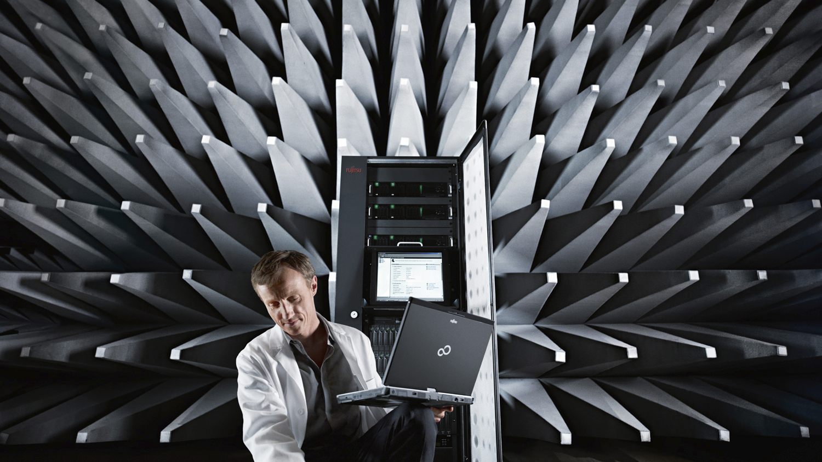
ETERNUS CD10000 Hyper Scale Storage Appliance

Slide 4

Nopeasti kohoavat tallennusmäärät ohjaavat uuteen teknologiaan
Traditional RAID systems face their limits when crossing the petabyte divide
High RAID rebuild times, high risk
Exponentially rising costs for HA
Over or under provisioning due to unexpected data growth
Extreme data migration duration
Significant issues with (planned) downtime
Costs per capacity
Performance issues
Need for new architectures

Traditional RAID systems

New storage architectures
0.5PB
1PB
10PB
20PB
100PB

Slide 5
Perinteinen Scale-out storage auttaa mutta..
Scale-out layer
Some storage vendors started to offer scale-out solutions by clustering RAID systems
Push limits by using additional capacity scaling, performance and reliability
BUT
The RAID problem still exists
Performance scalability is not linear and reaches saturation levels because of central data distribution mechanisms
There are still high capacity costs because of using purpose-built architectures plus additional hardware and software components

Slide 6
Miten perinteisen Scaleout Storage ja ETERNUS CD10000 erovat toisistaan
Classical scale-up, RAID storage
ETERNUS CD10000 Distributed scale-out storage
System is divided into RAID groups providing efficient data protection
Issues with rebuild times of large capacity disks
Protection against system failures requires external add-ons
Limited performance scalability inhibits full capacity utilization of systems
Issues with performance hot-spots
Data is broadly distributed over disks and nodes delivering high I/O speed even with slow disks
Protection against disk and node failures is achieved by creating 2, 3, 4 … n replicas of data
Distributed file system avoids central bottlenecks
Adding nodes provides linear performance scalability
Fault tolerance and online migration of nodes is part of the design → zero down time

Slide 7
Uusi scale-out storage Fujitsulta
Fujitsu will announce a petabyte scale, distributed and software-defined storage system in mid October 2014
The product is called ETERNUS CD10000
First customer proof-of-concepts are in execution
Based on Intel-Xeon PRIMERGY servers and Ceph Open Source software
Truly unified: block, object and file access
By offering a complete appliance with end-to-end maintenance ETERNUS CD10000 makes Ceph enterprise ready
Fujitsu add-on management functions

OpenStack Storage System Software Ceph

Fujitsu Server & Storage Hardware



Fujitsu Maintenance Services

Fujitsu Professional Services

Slide 8
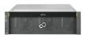
Hyperscale, software-defined storage: ETERNUS CD10000
Use Case Specific Interfaces
Up to 200 connected storage nodes deliver up to 50 PB capacity in minimum space
Host interface: 10GB Ethernet
Storage nodes interconnect: Infiniband
Software-defined storage: Ceph/Open Stack
Software enhancements for efficient mgmt.
Appliance approach makes open source based storage enterprise ready
Productive delivery of hardware and software, tested for full compatibility, optimized for performance and HA
Full maintenance and support with Fujitsu responsibility
Service packs / upgrades for secure lifecycle management after purchase
Cloud
Storage
Sync & Share
Archive
File Service
ETERNUS CD10000
Object Level Access
Block Level Access
File Level Access
Central Management
Ceph Storage System S/W and Fujitsu Extensions
Performance Nodes
Capacity Nodes
10GbE Frontend Network
Infiniband Backend Network

Slide 9
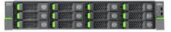
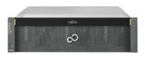
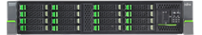
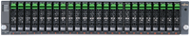
ETERNUS CD10000 – storage nodes
Storage nodes built around industry standard server technology using PRIMERGY Servers and ETERNUS JX JBODs
Up to 200 nodes released in the 1st version
Basic node
Performance node
Capacity node
Delivers 12.6TB using 2.5" SAS disks (10k rpm)
Basic node plus ETERNUS JX40
Adds 21.6TB of 2.5" SAS disks (10k rpm)
34.2TB total capacity
Basic node plus ETERNUS JX60
Adds 240TB of 3.5" SATA disks (7.2k rpm)
252.6TB total capacity

Slide 10

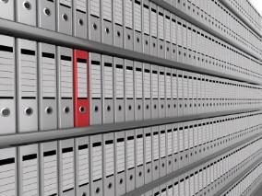

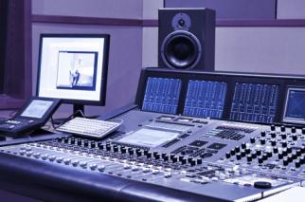

Tyypillisiä käyttökohteita
(Cloud) service providers
1
2
3
4
5
IaaS providers
Collaboration, Email, Sharepoint, DropBox services
(National) telco providers who are expanding in IT services
Large enterprises companies with in-house cloud services
IT organizations extending their DC usage in order to provide services for external customers as well
Providers with open source platform strategy (KVM, OpenStack, etc.)

Slide 11
Tyypillisiä käyttökohteita
Companies, public institutions, universities etc. with large online archives
1
2
3
4
5
Need online fast access to large amounts of current and historical data, e.g. research or legal documents, contracts
Use object data for efficient archiving
Reliable online storage for 500TB of data and beyond – no data migration to tape possible

Slide 12
Tyypillisiä käyttökohteita
Industry specific service providers (e.g. midsize banking, insurance companies)
1
2
3
4
5
High availability and a fast online store
Disaster recovery site for storage
Fast access for customer data and profiles
Zero downtime requirements

Slide 13
Tyypillisiä käyttökohteita
Media and broadcasting/streaming companies
1
2
3
4
5
Fast online streaming services with petabytes of video and audio data / mediastores
Real-time rendering and streaming process of high quality video data
Creation of fast copies for media with high access frequency
Fast growing data environment; secure consistent availability
Secure handling of petabyte data volumes
Zero downtime requirements

Slide 14

Copyright 2014 FUJITSU

